Slide 1
Improve User Adoption with Help Panes in model-driven apps
Raphaël Pothin – 02/22/2020

Slide 2








Join us at the Microsoft Offices in downtown Tampa on Feb 22, 2020!
Thank you ClickDimensions being a platinum sponsor
Visit https://www.365powerup.com/365poweruptampa for details!
Notes:
Tampa text Requires this font: https://www.fontsquirrel.com/fonts/permanent-marker

Slide 3





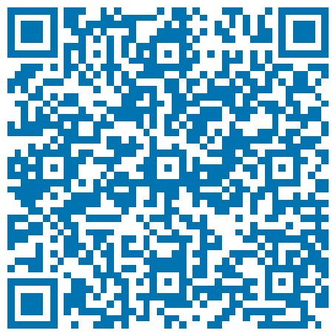


Who am I?
Power Platform Enthusiast
Business Solutions Consultant
(Dynamics 365 Sales, Project Service Automation and Human Resources)
@RaphaelPothin
Raphaël Pothin
Raphael POTHIN
Raphaël Pothin
raphael.pothin@gmail.com

Slide 4
Agenda
1
Introduction to User Adoption concept
2
Help features in model-driven apps
3
How Help Panes can help you improve your user adoption?

Slide 5
Introduction to User Adoption concept

Slide 6




Illustration of User Adoption
Project: Deployment of Dynamics 365 Sales to replace Excel files
Wine Company
Beer Company
Did not invest on user adoption
Did invest on user adoption

Slide 7
When invest in User Adoption?
Version 1
…
Last Version
For me, we should invest in User Adoption
during all the life cycle of our applications!
Notes:
Always communicate with users:
at the beginning, to know what they would like / what they expect from the application
during each cycle, to show them how the application is evolving and get feedbacks
at the end of each cycle, to train them and show what’s new
and do it again until the end of use of the application

Slide 8
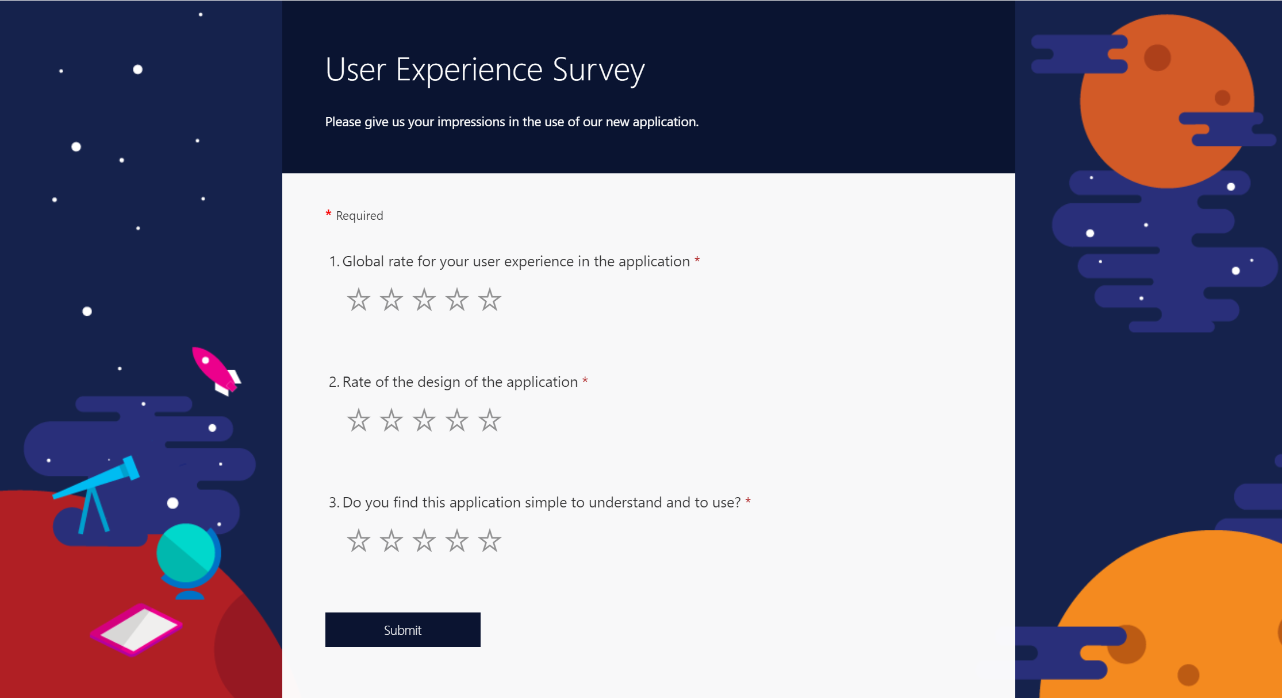
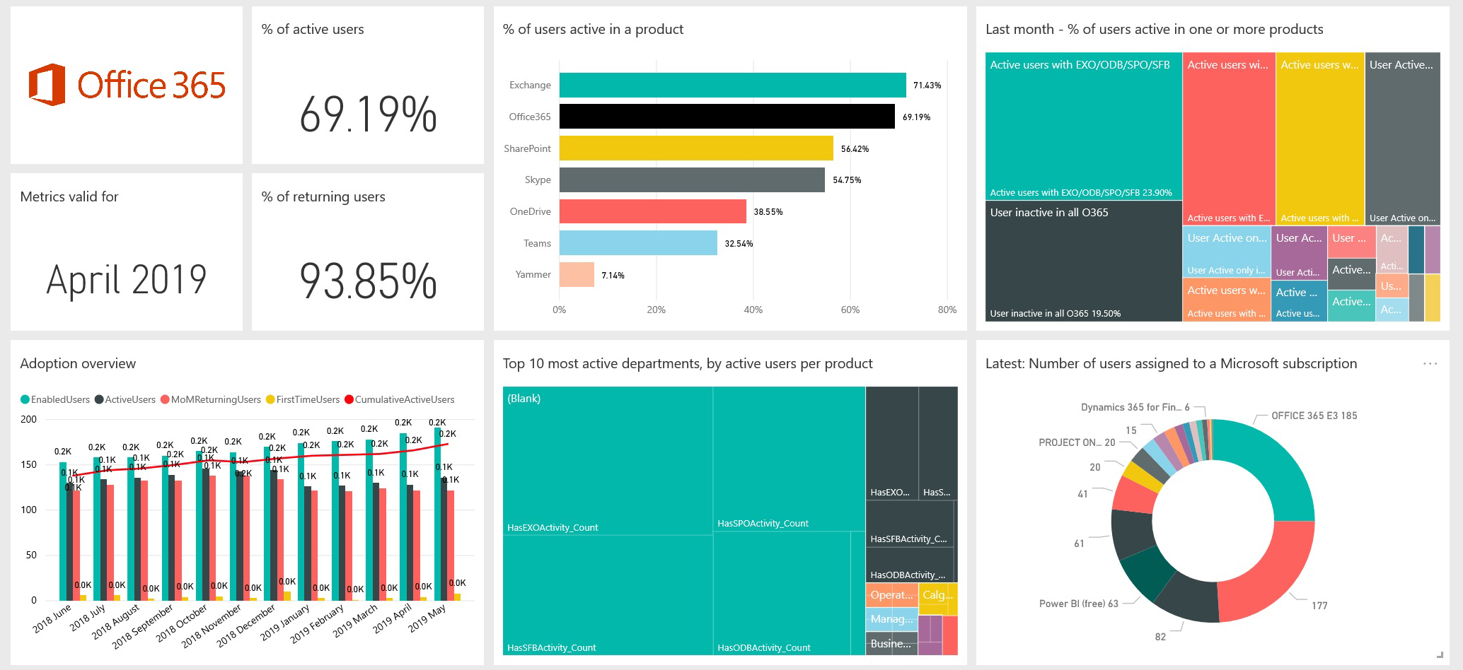
How to mesure User Adoption?
Notes:
Subjective indicators from surveys
Objective indicators with metrics gathered directly from the applications, logs…
Example: https://appsource.microsoft.com/en-us/product/power-bi/cia_microsoft365.microsoft-365-usage-analytics?tab=Overview

Slide 9
Help features in model-driven apps

Slide 10
3 main help modes in model-driven apps
By default, redirection to the Microsoft documentation
Configure a custom help URL where users will be able to find the resources they need
Last but not least, enable Help Panes that provide an immersive help experience for the users

Slide 11
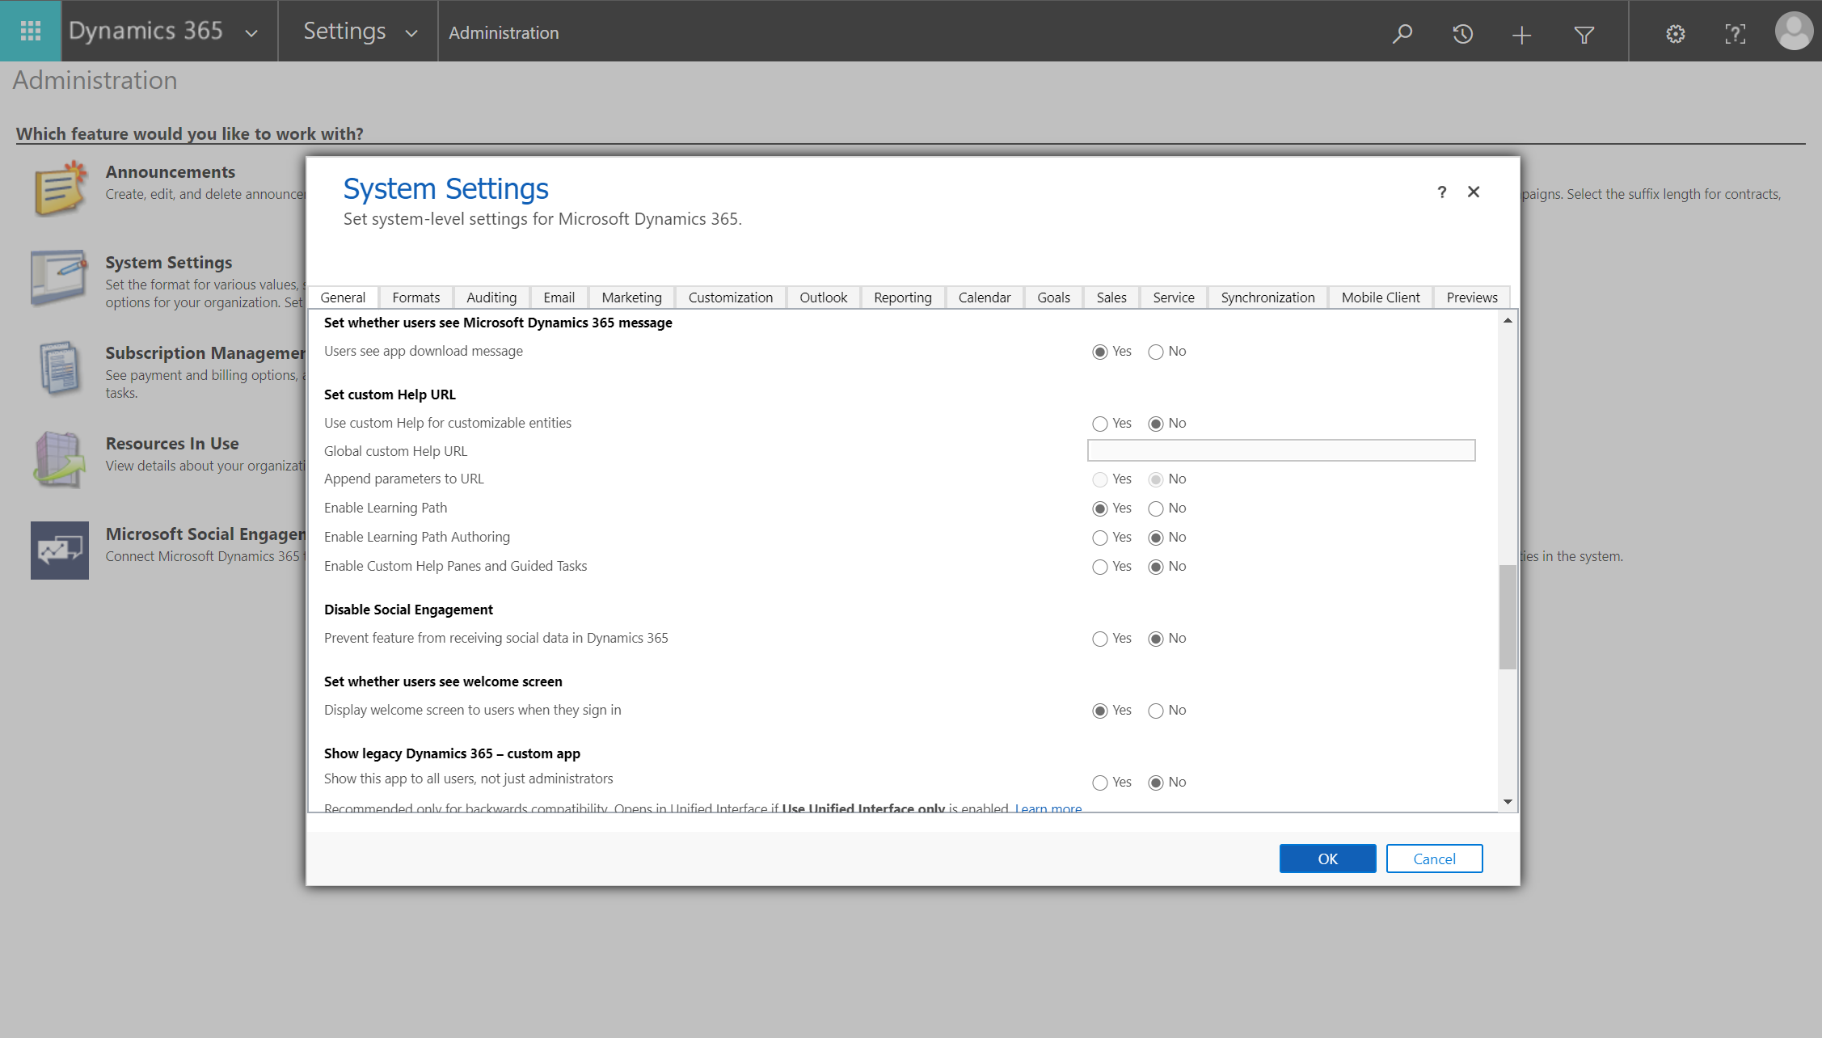
Switch between different kind of help features
Notes:
Show how to get to the help feature configuration: Settings > Advanced Settings > Administration > System Settings > Set custom Help URL section
Show the default configuration of the help feature: « Use custom Help for customizable entities » set to « No » and « Enable Custom Help Panes and Guided Tasks » set to « No »
Show how this default configuration of the help feature works on the Lead entity main form in the Help Panes Demo application → Open Microsoft documentation
Show how to configure a custom help URL: « Use custom Help for customizable entities » set to « Yes » and put the URL in the « Global custom Help URL »
Show how a custom help URL works on the Lead entity main form in the Help Panes Demo application → Open the custom Help URL configured
Show how to enable the custom Help Panes feature: « Use custom Help for customizable entities » set to « No » and « Enable Custom Help Panes and Guided Tasks » set to « Yes »
Show how custom Help Panes work on the Lead entity main form in the Help Panes Demo application → Open the custom Help URL configured → Display an empty custom Help Pane
Note: You need to refresh your page if you want to demonstrate the change in the configuration of the help feature.

Slide 12
How Help Panes can help you improve your user adoption?

Slide 13
Demo Configuration of an Help Pane
Notes:
Show the Help Pane in the Lead entity main form in the Sales Hub app → Help Panes not editable in out of the box apps
Configure the Help Pane on the Lead entity main form in the Help Pane Demo app: Lead qualification as the use case example
Update the title of the Help Pane
Add a short introduction at the beginning of the Help Pane with some text format changes
Add a section for the Qualification of a lead
Take a screenshot of the Qualify button, save it, upload it in a SharePoint site and add the image URL to the Help Pane as a link
Insert a video stored on Stream (uploaded before the presentation) showing an example of Lead qualification
Add a link to allow the user to consult the Microsoft documentation about the qualification of a Lead (ex: https://docs.microsoft.com/en-us/dynamics365/sales-enterprise/qualify-lead-convert-opportunity-sales)
Insert a coachmark point to the “Qualify” step of the “Lead to Opportunity” business process flow
Finally add a balloon on the Qualify button
Save your work
Show how it looks like from a user point of view on an open Lead
Configure the Help Pane on the Dashboard page in the Help Pane Demo app: Lead Quick Create as the use case example
Update the title of the Help Pane
Use coachmarks to show to the user where to go to quick create a Lead
Add a coachmark on the “View record” link after the Lead quick creation
Add a ballon on the “Qualify” step of the “Lead to Opportunity” business process flow
Show how it looks like from a user point of view on the dashboard page

Slide 14
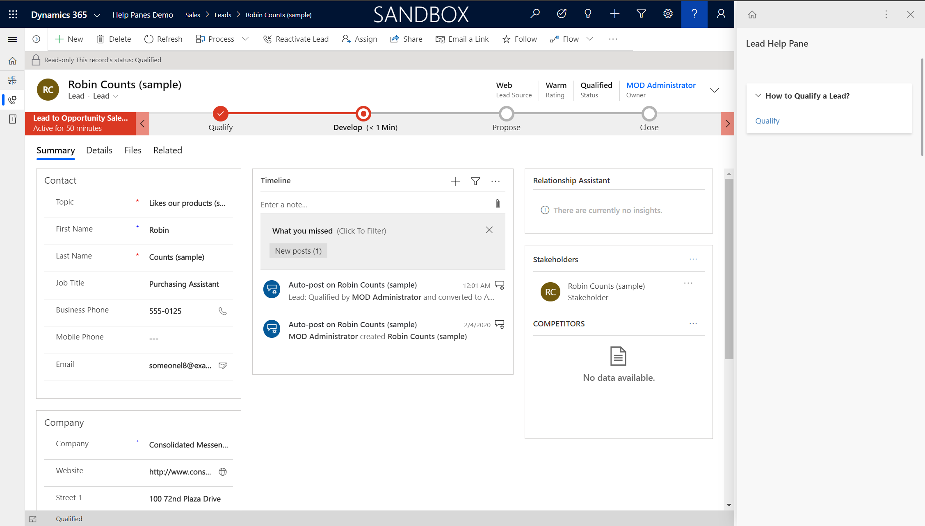
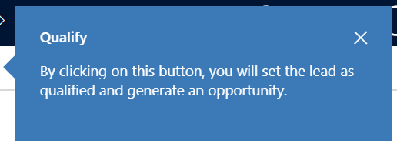
Quizz – Question 1
If I click on the ballon link regarding the Qualify button in the Lead main form Help Pane for a qualified Lead, what will happen?
A
B
A
B
Notes:
Demonstration of another similar example: balloon on a button in a subgrid on a the Opportunity main form that will not be displayed if the window is to small

Slide 15
Demo Manage Help Panes in the ALM
Notes:
In Power Apps, open the Solutions section
Then open the Help Panes Demo solution
Switch to classic mode
Go to the Help Pages section
Add the Help Panes configured in the previous steps of the demonstration
Open a Help Page record to show what we can find in it
Save and publish the solution
Export it and then import it to another environment where I previously have shown that I do not have the model-driven app I have used in the demonstration

Slide 16
Quizz – Question 2
I would like to update the configuration of a balloon in a Help Pane. How can I do it?
Solution A
In the Help Pane in Edit mode, click on the balloon, then edit its configuration.
Solution B
In the Help Pane in Edit mode, delete the balloon link then recreate it with the new configuration.
Solution C
In the Help Page record, edit the content carefully, then save it and finally save and publish the solution.
Solution A
In the Help Pane in Edit mode, click on the balloon, then edit its configuration.
Solution B
In the Help Pane in Edit mode, delete the balloon link then recreate it with the new configuration.
Solution C
In the Help Page record, edit the content carefully, then save it and finally save and publish the solution.
Notes:
Demonstrate the 2 known solutions to edit the configuration of a balloon:
Delete and recreate the balloon link (copy paste the title and the description of the balloon before)
In the Help Page record, get the “Content” field value and put it in a Visual Studio Code editor. Then, edit it, replace the “Content” field value in the Help Page record and save it. Finally save and publish the solution

Slide 17
Questions?

Slide 18
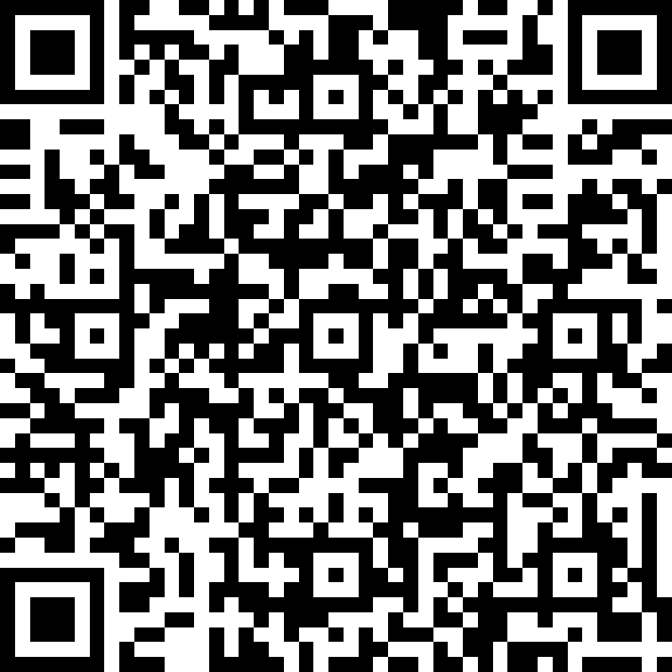
Thank You!

